Slide 1
Parks and Recreation
Group-Forecasters:
Eswar Hemant Majeti- G233R756
CS 896: Data Science Capstone Project
Summer 2023 (CRN 32292)
Instructor:
Dr. Fujian Yan
Fujian.yan@wichita.edu

Slide 2
Information on City of Lawrence
The city is located in between the Oregon and the Santa Fe trails, which run through Lawrence and Douglas County, KS
It was established in 1854
The LPRD facilities offer an excellent venue for all your private and public events, corporate functions, and fitness activities.
Our project revolves around the data regarding event bookings within the Parks and Recreation Department of the city of Lawrence.

Slide 3
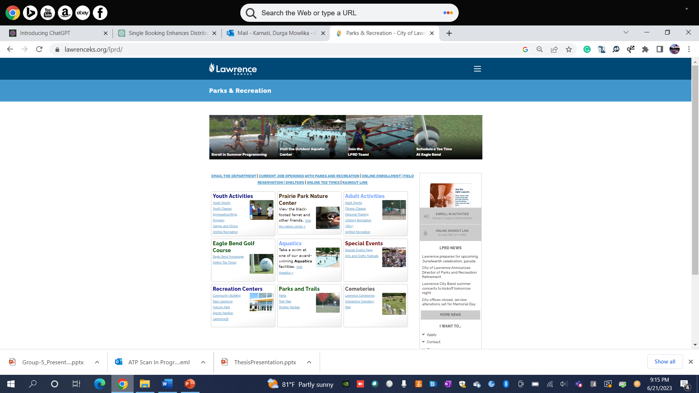
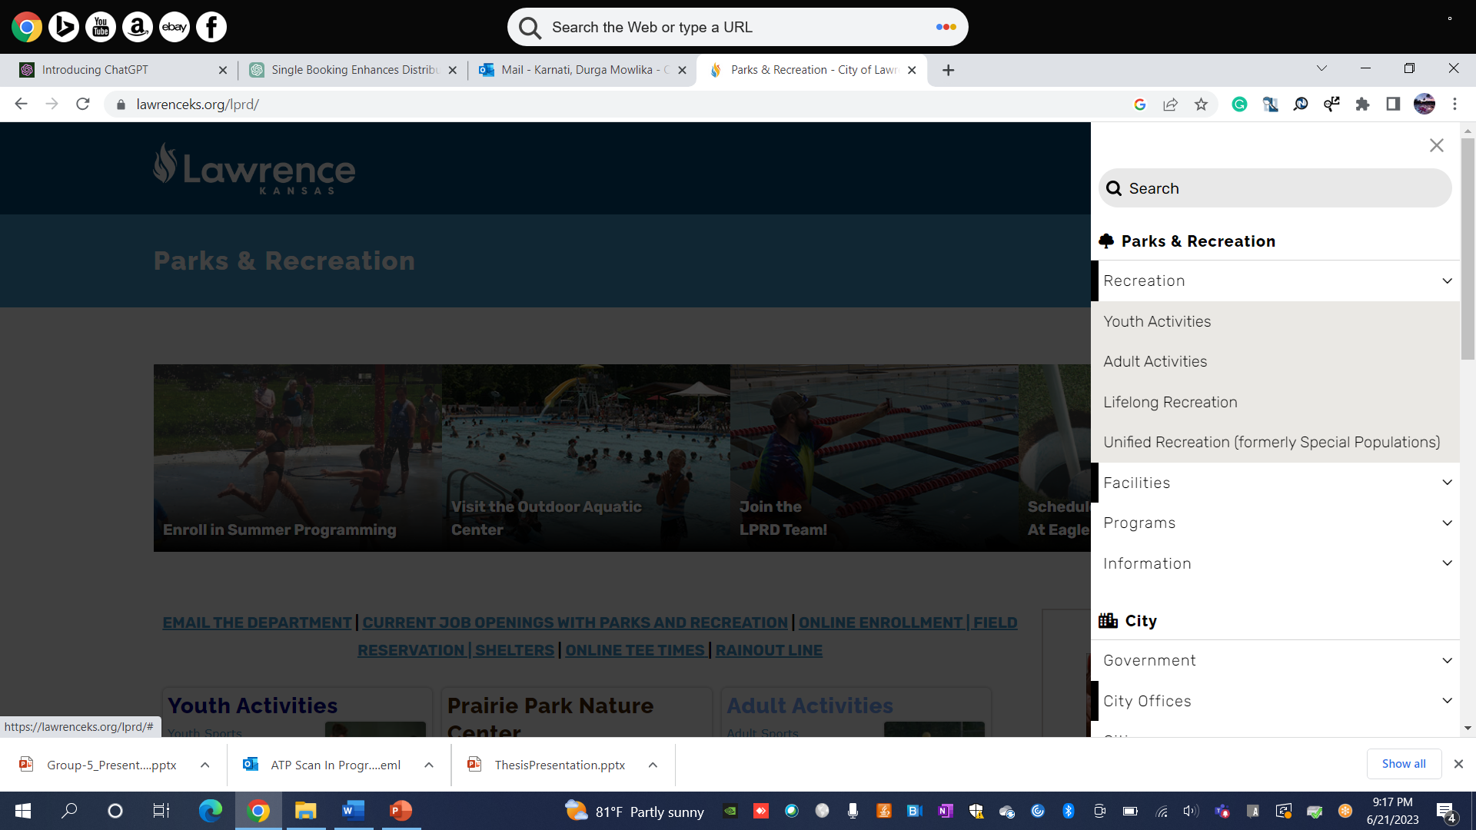
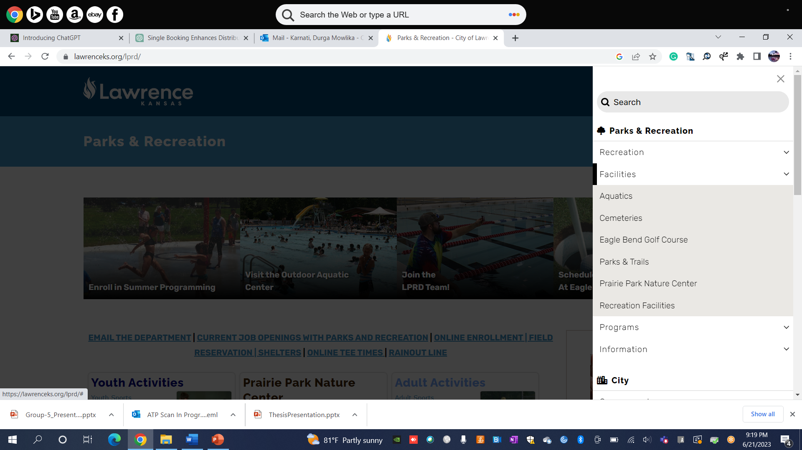
Website link:- https://lawrenceks.org/lprd/

Slide 4
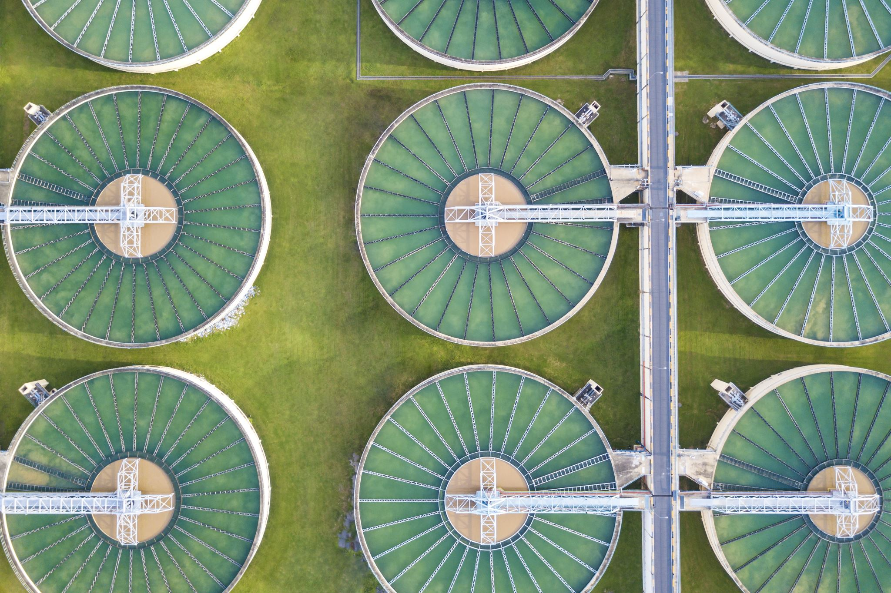
Facility Centers
Community Building (CB)
East Lawrence Recreation Center
(ELC)
Holcom Park Recreation Center
(HPC)
Holcom Sports Complex (HSC)
Sports Pavilion Lawrence (SPL)
Union Pacific Depot (UP Depot)
Carnegie Building

Slide 5
Community Building Facilities
Locker /Shower facilities
Full-size Gymnasium
Weight room
Shoulder Press Machine
Bicep and Triceps Machines
Cardio Equipment
Five Treadmills
Four Ellipticals
One Stationary Bike
Two Recumbent Bikes
Dance Studio
Meeting rooms with access to a kitchenette

Slide 6
Dataset Description
The Data provided consists of Facility calendar from the year 2013 to 2022.
There are 6 Facility Centers:
Stephen_Mason_Carnegie
Stephen_Mason_CB
Stephen_Mason_ELC
Stephen_Mason_HPC
Stephen_Mason_SPL
Stephen_Mason_UP Depot

Slide 7

The Data set consists of a total of 69 files
PDF: 59 Files consisting of yearly based facility calendar
XLS worksheet-10 Files consisting of yearly data of all locations

Slide 8
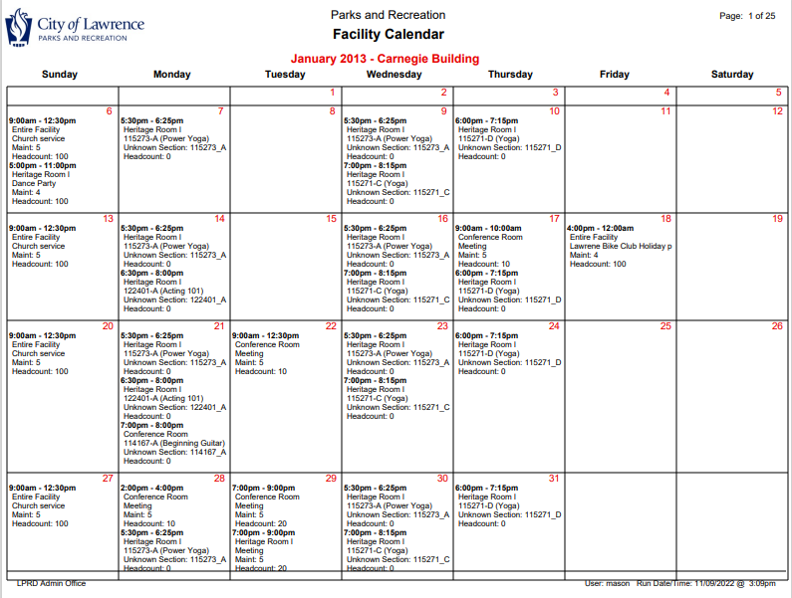
Facility Calendar

Slide 9


Size of Data set provided in Excel on yearly basis: [123649 rows x 11 columns]
2013- [8012 Rows x 11 Columns]
2014- [10632 Rows x 11 Columns]
2015- [13111 Rows x 11 Columns]
2016- [14459 Rows x 11 Columns]
2017- [15897 Rows x 11 Columns]
2018- [15536 Rows x 11 Columns]
2019- [15319 Rows x 11 Columns]
2020- [8380 Rows x 11 Columns]
2021- [9418 Rows x 11 Columns]
2022- [12885 Rows x 11 Columns]

Slide 10
Variable | Type | Description
Facility Class | Categorical | There are a total of 17 classes provided Each class has one or more facilities under it.
Facility Location | Categorical | Various building locations of LPRD
Facility Code | Categorical | Assigned code for each Facility in the buildings
Facility | Categorical | The type of Facility booked for various events
Status | Categorical | Status of the reservation(Firm, Hold, Internal, Tentative)
Reservation type | Categorical | Reservation type is a variable used to describe the type of booking it is. (Facility or Activity)
Begin Time | Time | Start time of the event.
End Time | Time | End time of the event.
Begin Date | Date | Start date of the event.
End Date | Date | End date of the event.
Head Count | Numerical | Number of people attending the event.
Variables Used

Slide 11
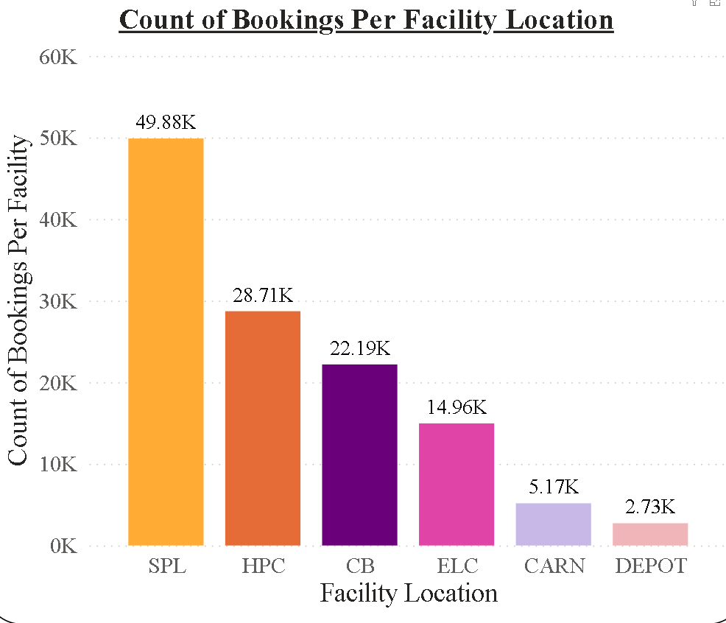
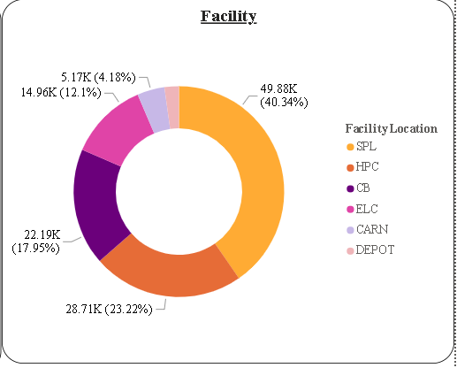
Count and percentage of Facility occupation
2.73 K (2.21%)

Slide 12
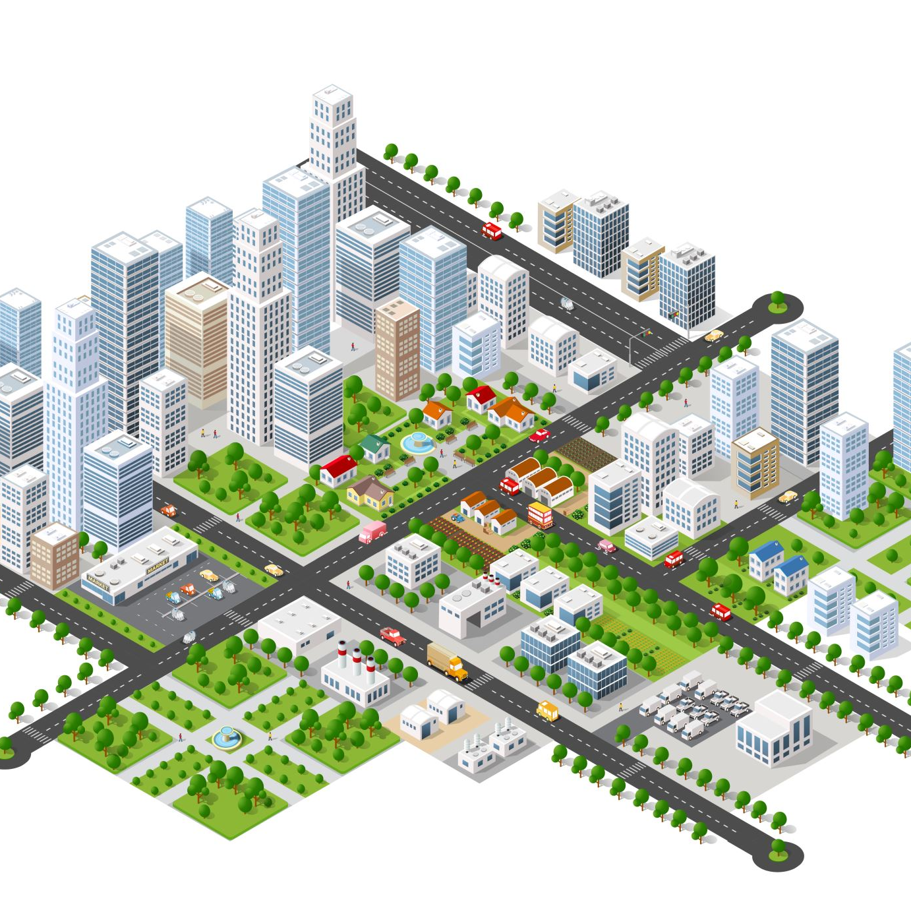
Problem Statement
Facilities allow multiple bookings per day. If Parks and Rec adjusted to allow only one booking per day, would demand be able to spread across the multiple facilities?

Slide 13
Action Items for the Project
Data Pre-Processing
Visualization
Implementation of Planned models in Project

Slide 14
Analysis Methods/Models Planned to use
Regression
Time Series Analysis

Slide 15

Tools and Software
SPSS
Power BI
Jupyter Notebook
MS Office

Slide 16
Challenges encountered with the dataset
The Provided Data is distributed across 69 files out of which 59 files are in PDF format and 10 are XLS files
The data Provided in the PDF are in calendar schedule format with different timings on each day
Extracting the data from these PDFs makes Data Pre-processing difficult and time taking process.
The extracted data need to be converted into Numerical format.

Slide 17
Tasks Distribution
Data extraction:- Eswar, Sudheer
Data Pre-processing:- Mowlika, Eswar, Sudheer
Python Coding:- Eswar, Mowlika, Sudheer
Visualization:- Eswar, Mowlika
Documentation:- Sudheer, Mowlika
Optional Comments: All the team members will be contributing to an extent in all the tasks, but their major part of contribution is mentioned as above.

Slide 18

Any Questions?

Slide 19

THANK YOU..!!

